Slide 1

Winter Delights Childcare Provider Workshop
January 16th, 2014
6:30 – 8:30 PM
WFSU

Slide 2

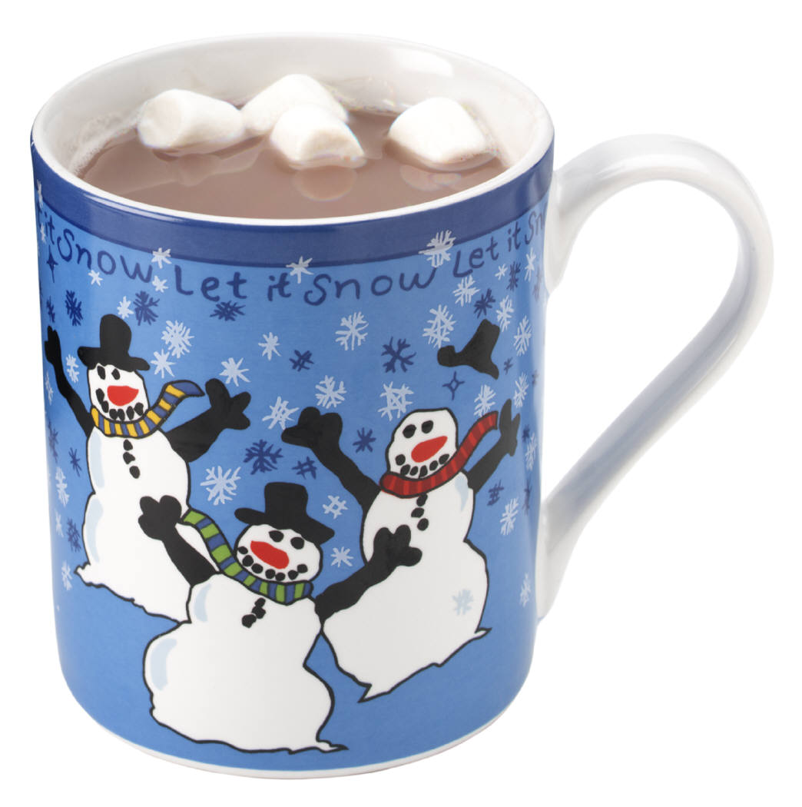
Welcome!!

Slide 3
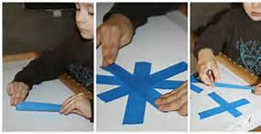
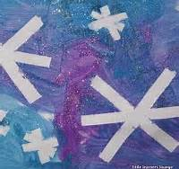
Snowflake Tape Resist

Slide 4
Skating with Dinosaurs
Show your children the “Dinosaurs in the Snow” episode of Dinosaur Train on PBS Learning Media and ask them what item might have made it easier for the dinosaurs to skate on the ice (answer = ice skates). Ask them if they have ever been ice skating before. Tell them that they are going to make some miniature ice skates to hang in the window.
http://florida.pbslearningmedia.org/resource/6b3960a1-4d9a-4a4b-bd25-af3e143234d0/6b3960a1-4d9a-4a4b-bd25-af3e143234d0/

Slide 5
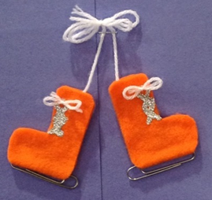
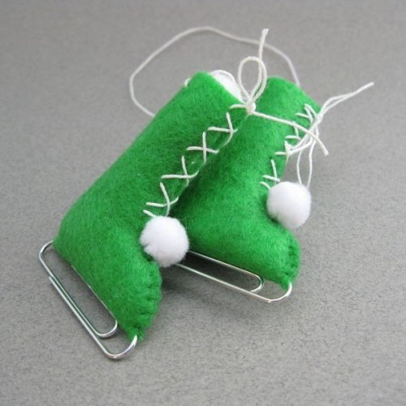
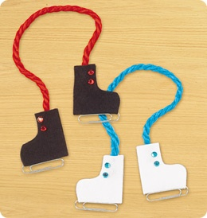
Paper Clip Ice Skate Craft

Slide 6
Fun with Snowmen
Watch this clip from Joy Learno (a segment from Between the Lions) on PBS Learning Media and discuss how snow forms and what a snowman is. Ask the children if they have ever made a snowman before. Tell them that they are going to make one today.
http://florida.pbslearningmedia.org/resource/btl10.ela.early.joylearnosnowman/joy-learno-snowman/

Slide 7
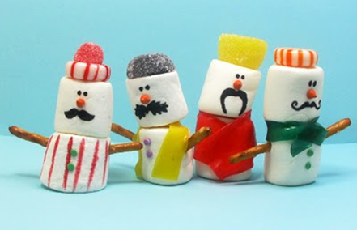
Mustache Marshmallow
Snowmen Craft

Slide 8

Snowflakes and Daniel Tiger
Watch this clip from Daniel Tiger’s Neighborhood on PBS Learning Media in which Daniel and his parents discuss how no to snowflakes are alike. Start a discussion with your children about how people are different just like snowflakes. Tell them that they are going to make their own unique, beautiful snowflakes.
http://www.youtube.com/watch?v=7-oMBo2Erhk

Slide 9
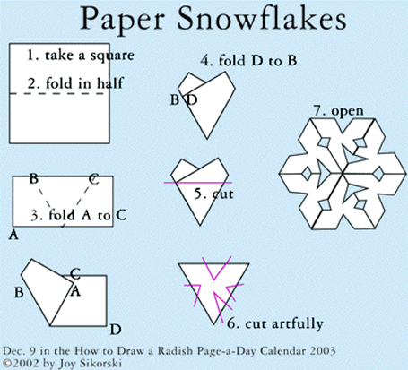
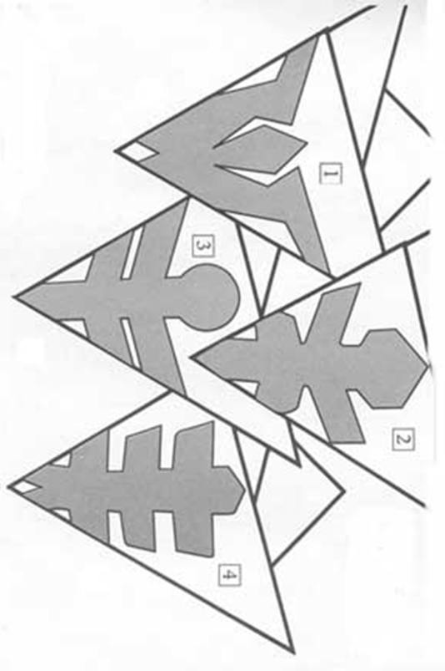
Unique Snowflakes

Slide 10
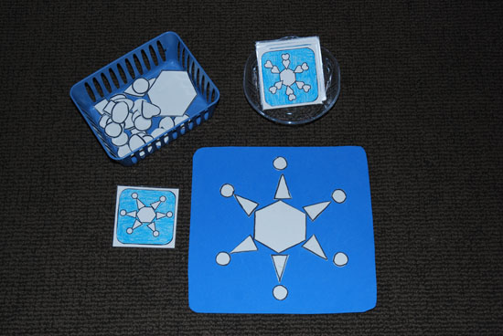

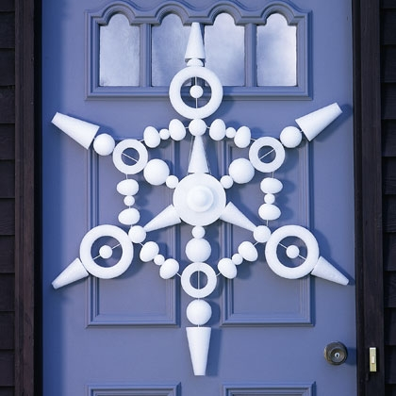
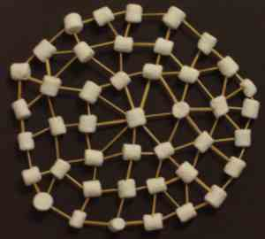
Build a Snowflake

Slide 11

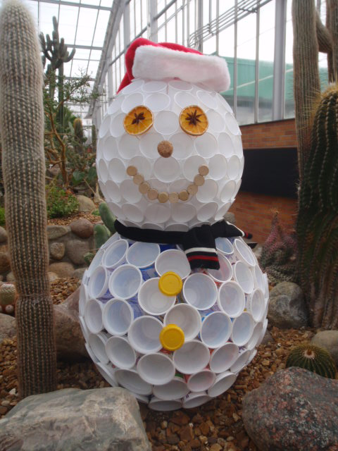
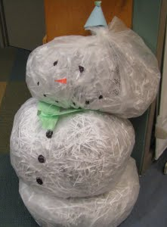
The Biggest Snowman Ever!

Slide 12
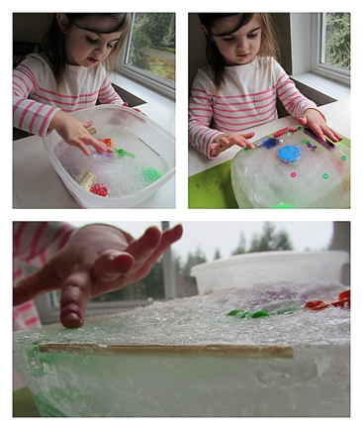
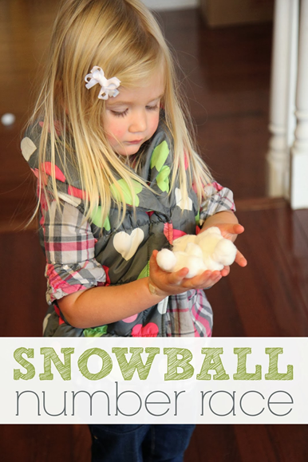
Snowballs and Icebergs

Slide 13
Stay Warm!!
Thank-you for coming out and we will see you on February 6th for the next workshop…
Love is In… On…
and
Over the Air!

